Slide 1
MHS- Counties with Housing
Fresno
Madera
Kings
San Bernardino
Contra Costa
Kern
San Diego
Tulare*
Santa Clara*

Slide 2
Fresno New Starts
Improving lives through innovation dignity integrity hope Action
and excellence.

Slide 3
Fresno New Starts
Making Lives Betters
Helping the community
Providing a safe and clean environment
Kid friendly
In house case management
We provide treatment plans
In house housing specialist
Caring staff

Slide 4
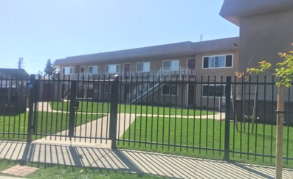
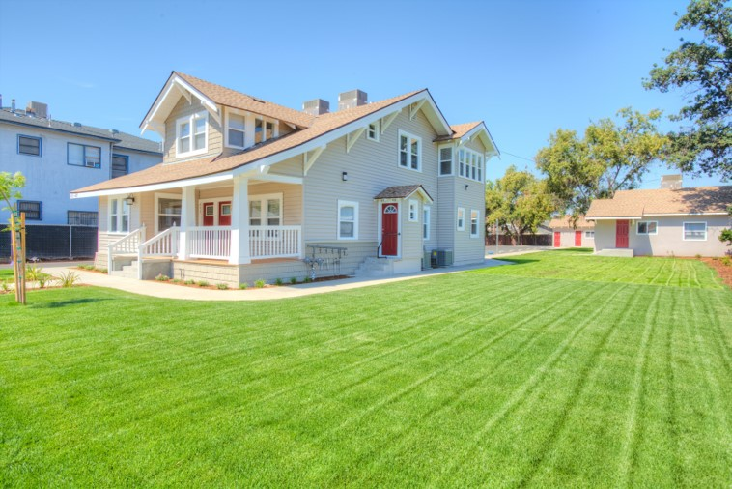
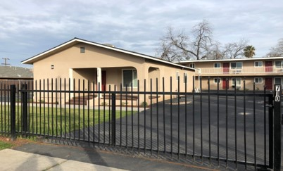
Fresno New Starts Master Lease Program Began in May 2017 as a pilot to serve those individuals who are receiving services from the Fresno County Department of Behavioral Health. We initiated the program with a 25-client capacity. Since then we have more than doubled in size and are currently serving 70 clients in 70 master leased units.

Slide 5
Glenn property
Before
After

Slide 6
473 N Glenn Ave Fresno, CA
1 bedrooms
Fully furnished
Newly renovated
Wash house with free washers and dryers
Clean patio area
Beautiful land scape
Security gate
parking

Slide 7
Yosemite Property
Before
After

Slide 8
462 n Yosemite ave Fresno, ca
1 bedrooms
Fully furnished
Newly renovated
Wash house with free washers and dryers
Beautiful land scape
Security gate
parking

Slide 9
Saginaw way property
Before
After

Slide 10
36 e Saginaw way Fresno, ca
1 & 2 bedrooms
Fully furnished
Newly renovated
Wash house with free washers and dryers
Beautiful land scape
Security gate
Parking

Slide 11
Bond property
Before
After

Slide 12
710 n Bond Fresno, CA
1 bedrooms
Fully furnished
Newly renovated
Wash house with free washers and dryers
Beautiful land scape
Security gate
Parking

Slide 13
Thank You

