Slide 1
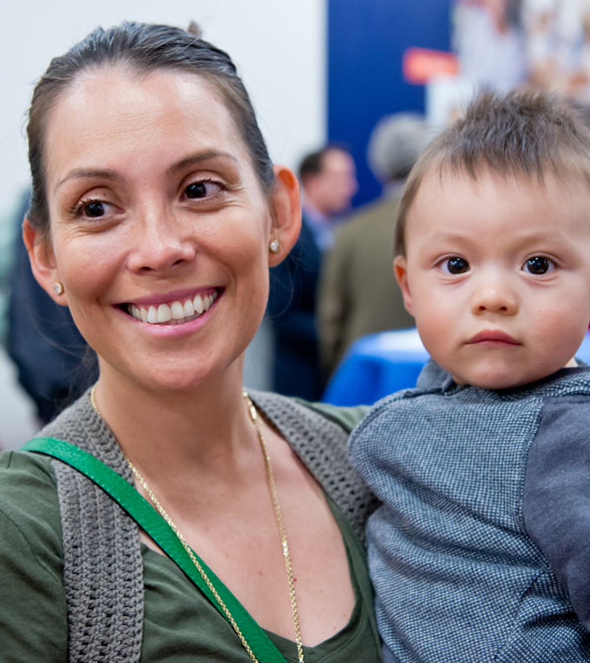
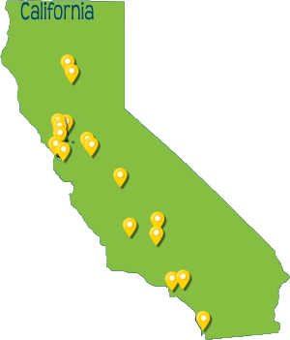

About Self-Help FCU
Creating and protecting ownership and economic opportunity for all, especially people of color, women, rural residents and low-wealth families and communities.
80,000 members
29 branches – 6 in CV
More than $1 billion in assets to invest in the communities we serve.
Notes:
Member-owned Co-operative Credit Union
Focus on low-wealth families and communities
6 Full service branches in the Central Valley
Operate with both mission and sustainability (double bottom line)

Slide 2
Who We
Serve
74%
84%
68%
25%
50%
Notes:
Fresh Start Loans
Consumer
Mortgage
Commercial

Slide 3
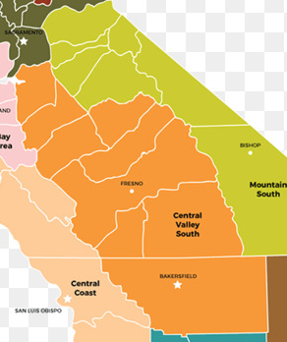
Our impact in the San Joaquin Valley
6 full-service branches
Developing a Sacramento branch
$344 Million deployed through 17,252 responsible loans
1,208 affordable home loans
15,611 consumer loans
74% loans to low-income individuals and families
84% loans to people of color
Growth of Commercial Lending in the Valley…
Notes:
#s are EVER-TO-DATE
Fresno was 1st de-novo branch. We now have the model.

Slide 4
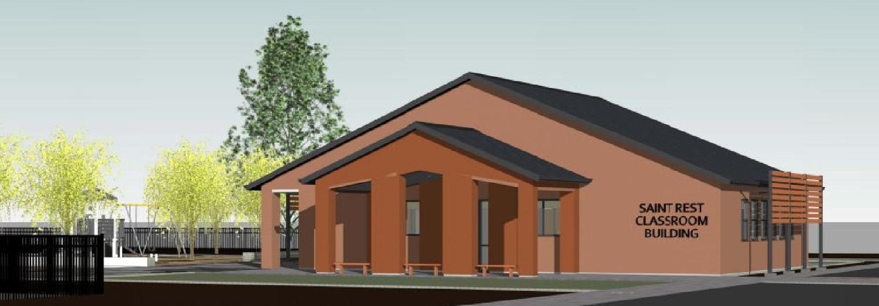
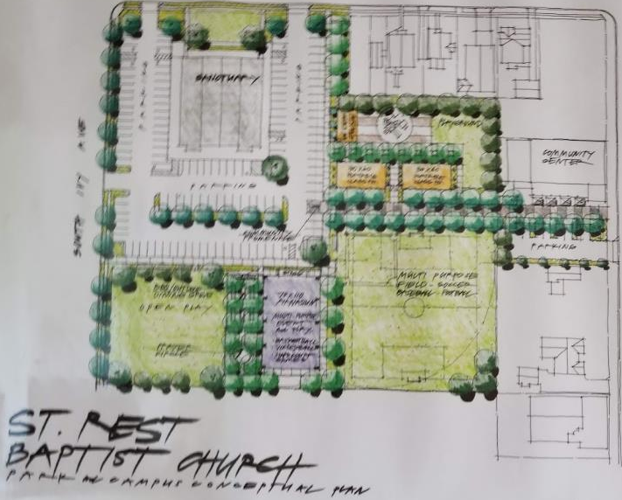
Partnership:
Commercial
Lending
Saint Rest Economic Development Corporation
Community Center & Park in Southwest Fresno
Grant from Kaiser Foundation for build out of park space
Notes:
Mention we do Multifamily / affordable workforce housing
Park: Grant from Kaiser Permanente and St Rest cash
Bank after bank told them no
Saint Rest is located in one of Fresno's poorest neighborhoods and is well known for its community engagement in West Fresno, including tutoring and literacy programs at the local High School, hosting a farmers market, a foster care ministry, youth leadership ministry, a weekly food donation program partnering with the local food bank, and the recently completed development of “St Rest Plaza”, a community venue to host events. The City of Fresno and community leaders view the church and its fairly new Economic Development Corporation as one of the only drivers of community development in this neighborhood.
The proposed building will enhance Saint Rest’s mission and operations in the following ways:
West Fresno has a critical lack of green and park space. The proposed park space and landscaping that will surround this building will provide a safe oasis where children can play and people can gather.
Saint Rest has a young and growing congregation which requires this additional space for Sunday School and programs. The new building will allow them to keep attracting more members.
The construction of a nice, new building that can be used and/or rented for gatherings and receptions is being viewed by City leaders as a significant development in a very economically depressed neighborhood. West Fresno hopes this will be a catalyst for future development, or at least provide hope for this community.

Slide 5
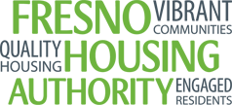
Partnership:
Secondary
Market Purchase
Fresno Housing Authority
49 Single Family Residence Units
Mortgage servicing
Notes:
Secondary Market purchases: 4.5B invested, 48 states, 33 lenders
$49M in Central Valley to-date
Freeing up capital for Fresno Housing Authority to develop more units – $3.3M
Allows each agency to focus on what it does best

Slide 6
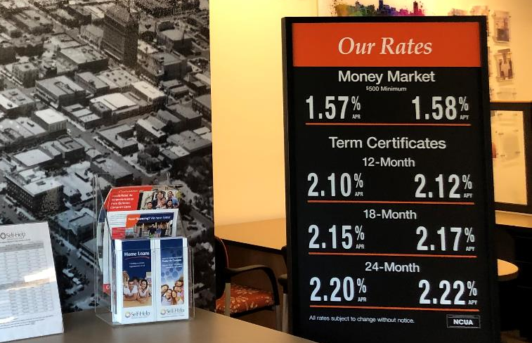
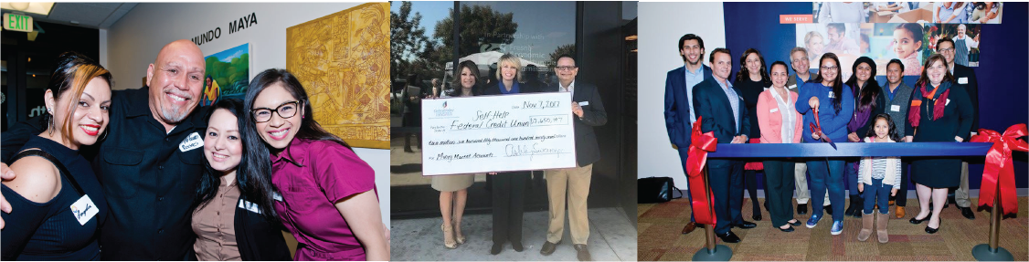
Increased Access: Branch Expansion
Home Ownership for all
Community Development Lending
Advocacy to encourage responsible lending
Partnering for Community Development
Notes:
We are looking for Mission Supported Investments – relatively high returns on CD’s and Money markets…, non-profits, churches, individuals of conscience
CVCF / CCLS Partnerships
Increased access includes FinCap/Financial education
Home ownership=affordable housing. (75% of our borrowers in SJV are low income)
Mention CRL! Advocacy to promote responsible + curb predatory lending. (PROTECT our members)

